Slide 1
Distributed Systems Week 5 - Rest Principles

Slide 2
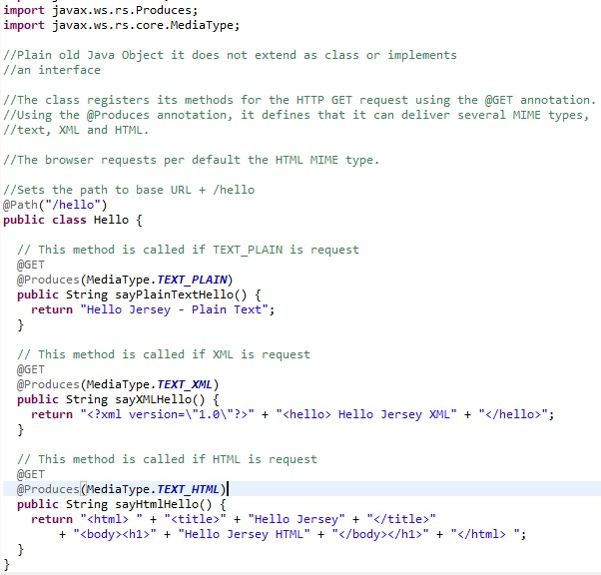
Last Week
Distributed Systems - Week 5: REST principles

Slide 3
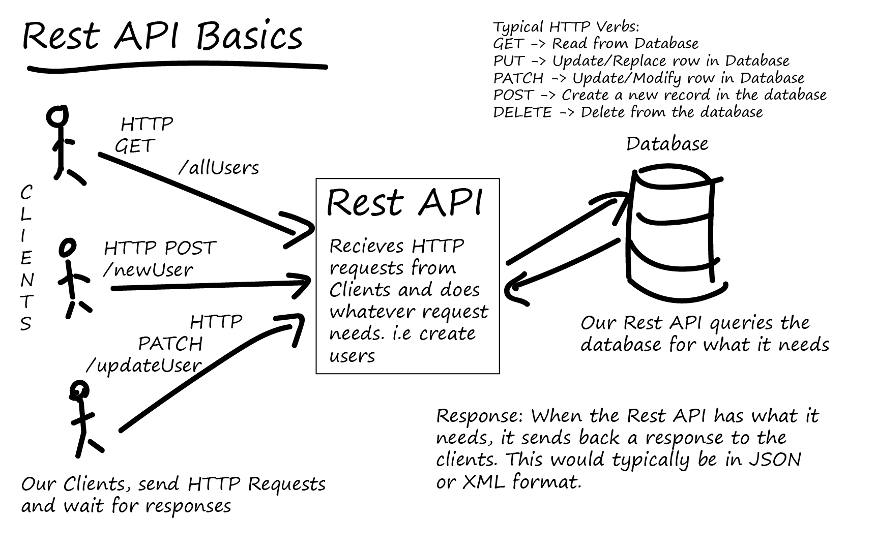
Remember what we are trying to do
Communicate in a simple way
Understand each request without any prior knowledge
Represent the resource/data in a way that suits the client
Distributed Systems - Week 5: REST principles

Slide 4
Why REST
While REST stands for Representational State Transfer, which is an architectural style for networked hypermedia applications, it is primarily used to build Web services that are lightweight, maintainable, and scalable.
A service based on REST is called a RESTful service. REST is not dependent on any protocol, but almost every RESTful service uses HTTP as its underlying protocol
Distributed Systems - Week 5: REST principles

Slide 5
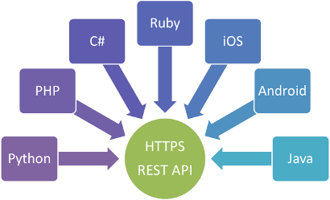
SEPARATION OF CLIENT AND SERVER
Every major development language now includes frameworks for building RESTful Web services
The implementation of the client and the implementation of the server can be done independently without each knowing about the other.
This means that the code on the client side can be changed at any time without affecting the operation of the server, and the code on the server side can be changed without affecting the operation of the client.
Distributed Systems - Week 5: REST principles

Slide 6
REST Principles/Constraints
A RESTful design promises that and more. In general, RESTful services should have following properties and features:
Identifiable resources
Give everything an ID
Hypermedia as the Engine of Application State (HATEOAS)
Link things together
Uniform Interface
Use standard methods
Resource Representations
Resources with multiple representations
Stateless Communication
Communicate without knowledge of previous requests
Distributed Systems - Week 5: REST principles

Slide 7
Identifiable Resources
Every system uses resources. These resources can be pictures, video files, Web pages, business information, or anything that can be represented in a computer-based system. The purpose of a service is to provide a window to its clients so that they can access these resources. Service architects and developers want this service to be easy to implement, maintainable, extensible, and scalable.
Every resource gets an ID
customer/12
customer/orders/56
product/76
Distributed Systems - Week 5: REST principles

Slide 8
HATEOAS
Hypermedia as the Engine of Application State (HATEOAS)
– "A REST client enters a REST application through a simple fixed URL. All future actions the client may take are discovered within resource representations returned from the server
What does this mean??
It means we can take action based on results / url’s we receive back !
Distributed Systems - Week 5: REST principles

Slide 9
HATEOAS IMPLEMENTATION
In the real world, when you visit a website – you hit its homepage. It presents some snapshots and links to other sections of websites. You click on them and then you get more information along with more related links which are relevant to the context.
Similar to a human’s interaction with a website, a REST client hits an initial API URI and uses the server-provided links to dynamically discover available actions and access the resources it needs.
The client need not have prior knowledge of the service or the different steps involved in a workflow. Additionally, the clients no longer have to hard code the URI structures for different resources. This allows the server to make URI changes as the API evolves without breaking the clients.
Distributed Systems - Week 5: REST principles

Slide 10
HATEOAS Example:
HATEOAS – Get a list of users.
This returns a list containing the unique identifiers to all the users.
The client can then send a request for information about a particular user.
Distributed Systems - Week 5: REST principles

Slide 11
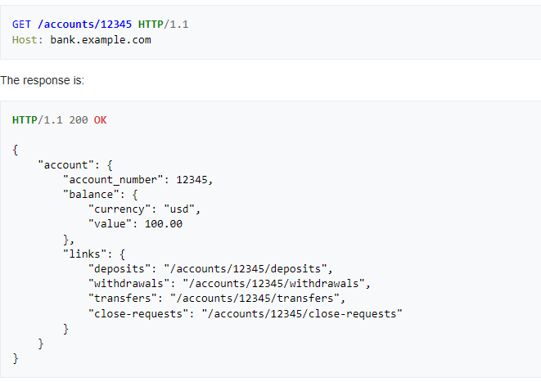
HATEOAS Example:
Distributed Systems - Week 5: REST principles

Slide 12
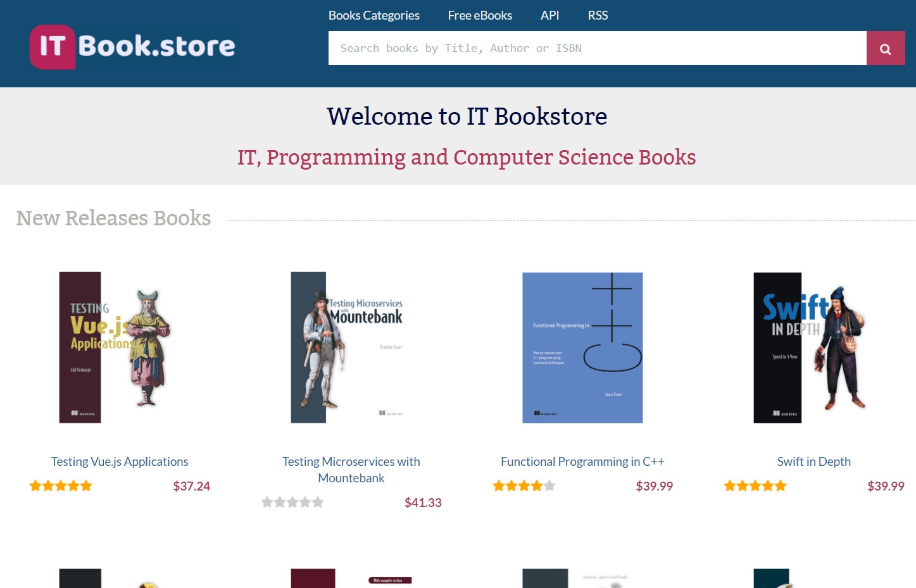
ITBook.Store example of HATEOAS
Distributed Systems - Week 5: REST principles

Slide 13
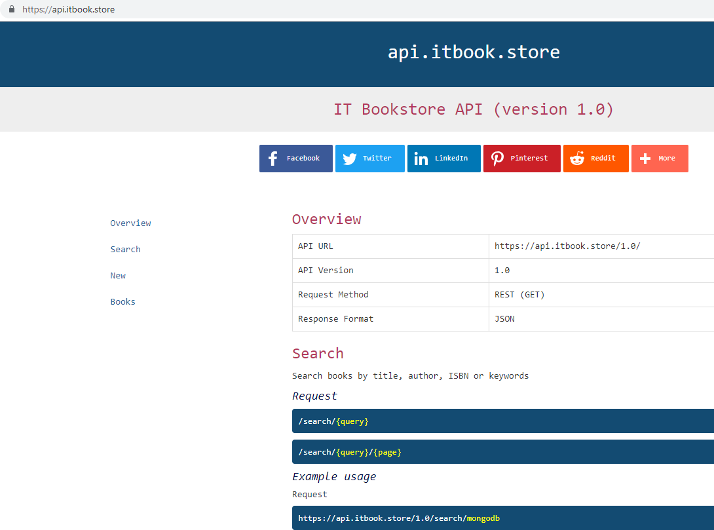
ITBook.Store example of HATEOAS
Distributed Systems - Week 5: REST principles

Slide 14
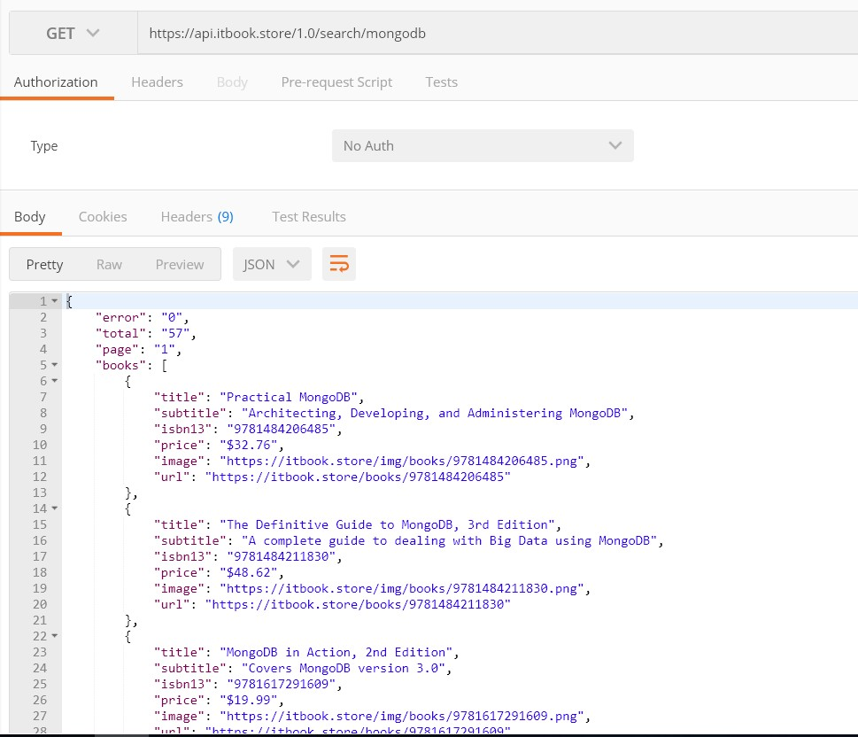
ITBook.Store with JSON response
Distributed Systems - Week 5: REST principles

Slide 15
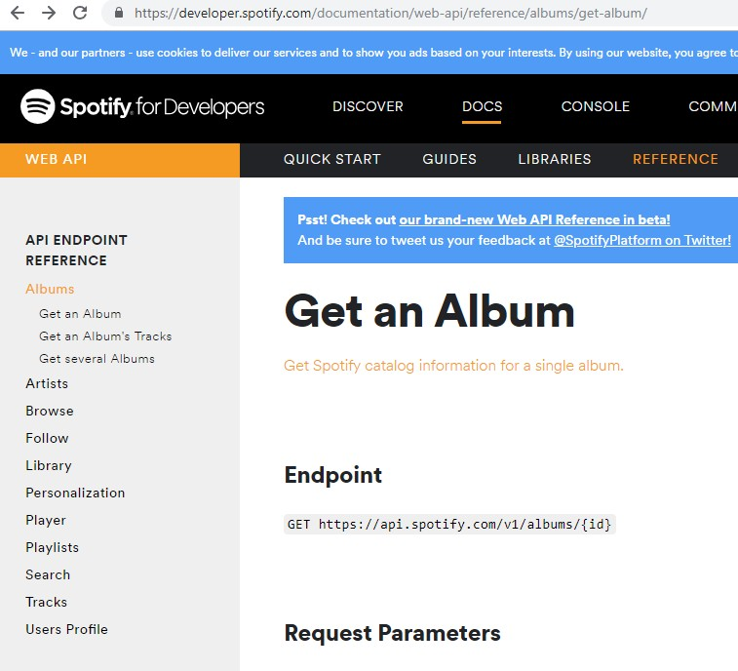
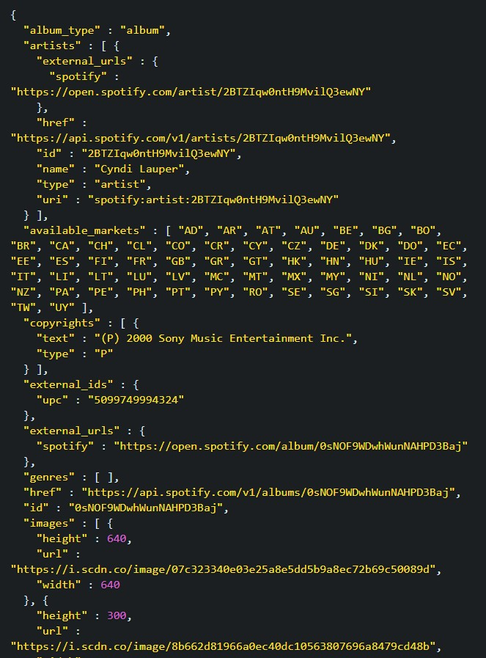
Spotify example of HATEOAS
Distributed Systems - Week 5: REST principles

Slide 16
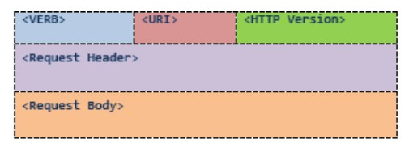
Uniform Interface
Every resource supports the same interface
<VERB> is one of the HTTP methods like GET, PUT, POST, DELETE, etc
<URI> is the URI of the resource on which the operation is going to be performed
<HTTP Version> is the version of HTTP, generally "HTTP v1.1" .
<Request Header> These settings contain information about the message and its
sender like client type, the formats client supports.
<Request Body> is the actual message content. In a RESTful service, that's where the representations of resources sit in a message.
Distributed Systems - Week 5: REST principles

Slide 17
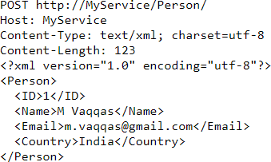
Uniform Interface - Sample POST request.
Distributed Systems - Week 5: REST principles

Slide 18
Resource Representations
The focus of a RESTful service is on resources and how to provide access to these resources. A resource can easily be thought of as an object as in OOP. A resource can consist of other resources.
You can use any format for representing the resources, as REST does not put a restriction on the format of a representation.
Distributed Systems - Week 5: REST principles

Slide 19
Resource Representations
Services can return various representations e.g.
HTML, XHTML, XML, JSON, plain text, Atom, CSS, CSV etc...
Using HTTP content-negotiation, a client specifies the formats it can accept and its preference
Accept: application/json
The server responds (using the Content-type header to indicate the format type in the entity body)
Distributed Systems - Week 5: REST principles

Slide 20
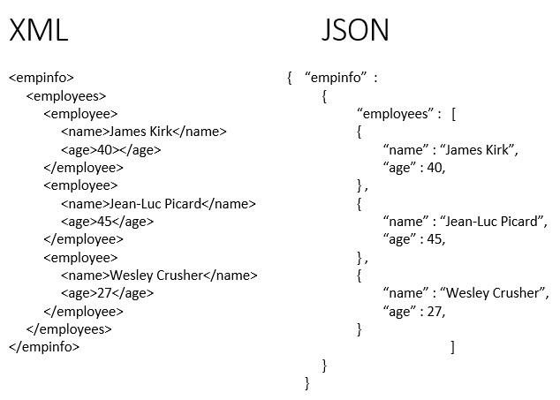
Resource Representations example
Distributed Systems - Week 5: REST principles

Slide 21
Stateless Communication
Every request happens in complete isolation
When the client makes an HTTP request, it includes all information necessary for the server to fulfil that request
The server never relies on information from previous requests
If an application is stateless (no session or application state) it can scale easily.
Just deploy more instances of your Web Application.
If it is not stateless, you need to go back to the same instance which has your session state.
Distributed Systems - Week 5: REST principles

Slide 22
Stateless Communication
A RESTful service is stateless and does not maintain the application state for any client.
A request cannot be dependent on a past request and a service treats each request independently.
A stateless design looks like so:
Request1: GET http://MyService/Persons/1
Request2: GET http://MyService/Persons/2
Each of these requests can be treated separately.
Distributed Systems - Week 5: REST principles

Slide 23
Stateless Communication
A stateful design, on the other hand, looks like so:
Request1: GET http://MyService/Persons/1
Request2: GET http://MyService/NextPerson
To process the second request, the server needs to remember the last PersonID that the client fetched. In other words, the server needs to remember the current state — otherwise Request2 cannot be processed.
Design your service in a way that a request never refers to a previous request.
Stateless services are easier to host, easy to maintain, and more scalable. Plus, such services can provide better response time to requests, as it is much easier to load balance them.
Distributed Systems - Week 5: REST principles

Slide 24
REST - Books Server Example

Slide 25
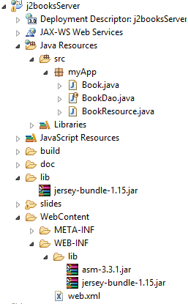
REST Book Server - JEE
Dynamic Web Project
Web.xml edit
Lib folder – Jersey lib (Build Path)
WEB-INF Lib Folder – Jersey + Asm lib
Distributed Systems - Week 5: REST principles

Slide 26
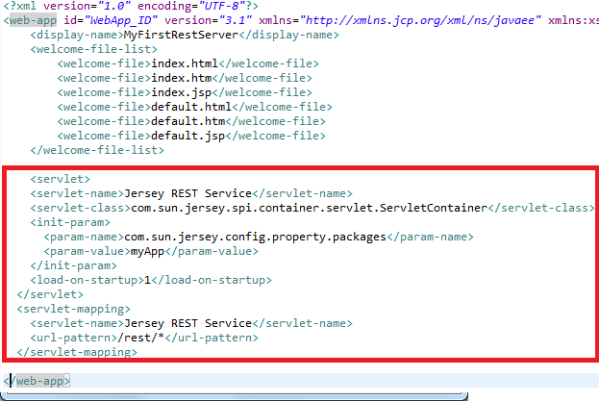
Editing Web.xml
Reference our package
Define our url pattern
This lets our project know about Jersey REST Service Mappings !
Distributed Systems - Week 5: REST principles

Slide 27
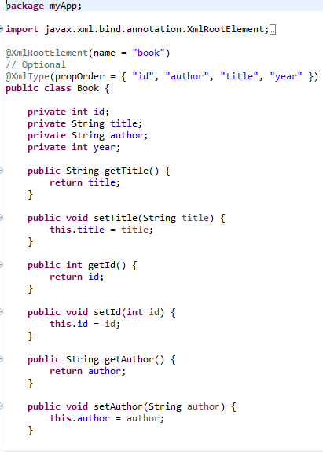
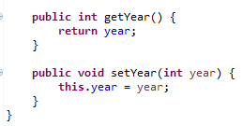
Book
Book Object with attributes:
Id
Title
Author
year.
Distributed Systems - Week 5: REST principles

Slide 28
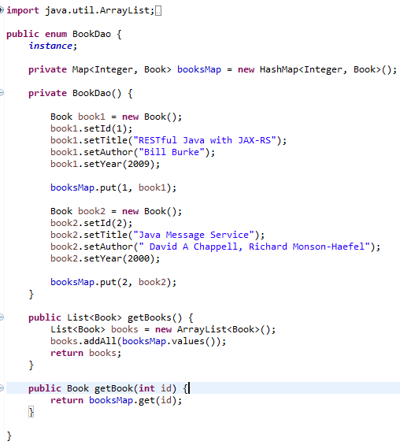
BookDAO
BookDAO – Data Access Object
HashMap used to hold book objects
List method to return all books
Get method returns single book
Distributed Systems - Week 5: REST principles

Slide 29
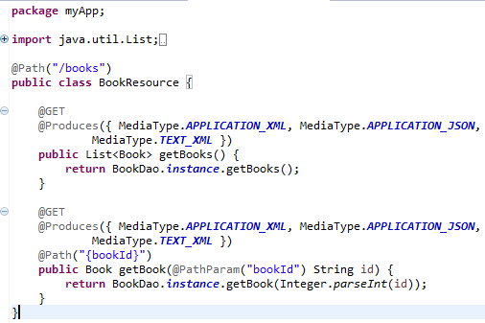
BookResource
Rest Jersey Code
Path handles request
Annotations @Get & @Produce determine call and returned resource content type
Distributed Systems - Week 5: REST principles

Slide 30
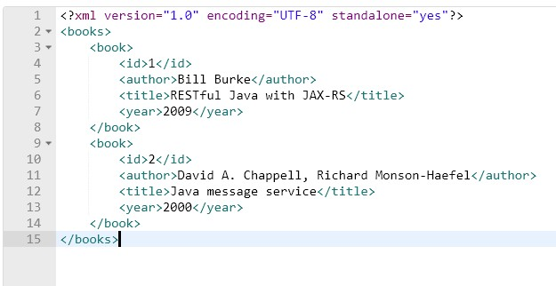
Output
Run Resource on Apache Tomcat
Enter Url:
http://localhost:8080/MyRestServer/rest/books
List of books returned in XML format
Distributed Systems - Week 5: REST principles

Slide 31
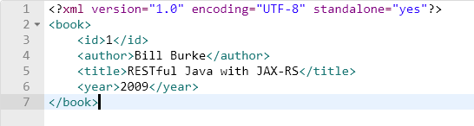
Output
Now append book ID to URL
Enter Url:
http://localhost:8080/MyRestServer/rest/books/1
Individual book returned in XML format
Distributed Systems - Week 5: REST principles

